Slide 1
Retrofit & Training
Holly Hansen-Maughan

Slide 2
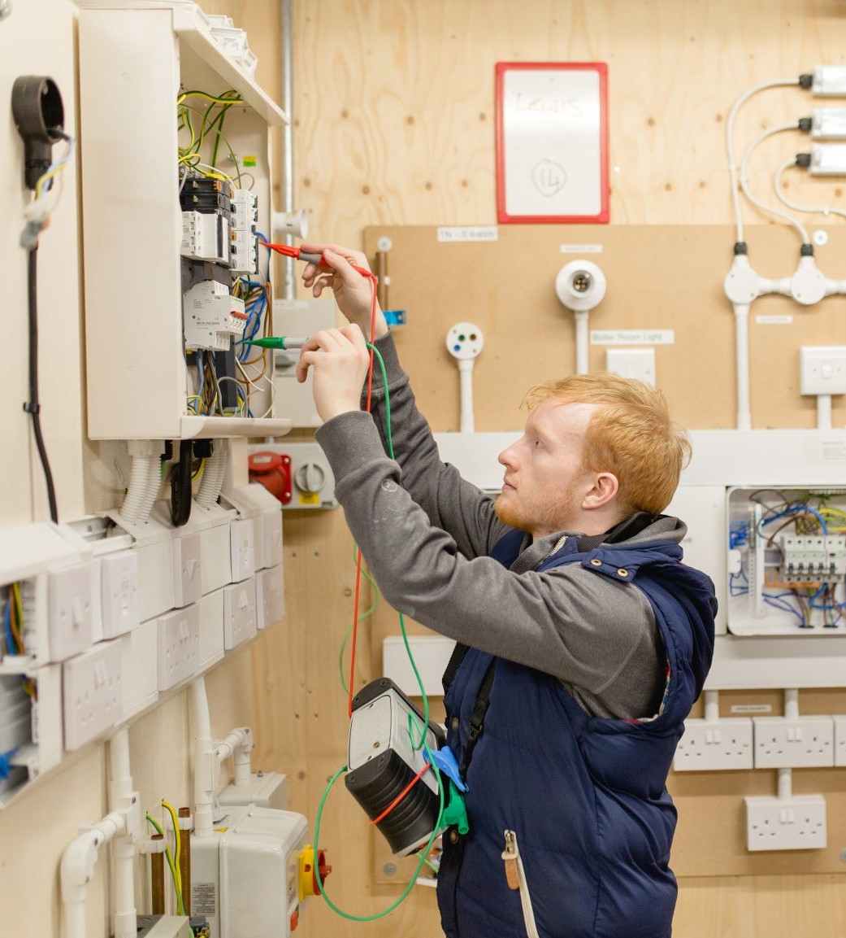
Strategic Development Fund: Skills Accelerator
Collaborative retrofit project
Craven college, third sector partners, 30+ businesses support
Demonstrated need - changes in regs, sector and climate targets
Spend on training, staff and awareness raising
People Powered Retrofit : Foundations of Eco-Renovation
Costed course, subsidised by third sector partner
(12th & 19th March course still open)
Domestic Energy Assessment, Retrofit Assessment

Slide 3
Third party funding
Partner Zero Carbon Harrogate. They had 2 successful bids which aimed to kick start green skills and named Harrogate as the skills provider.
Funded places on courses from them over a 2 year period, including:
6 people funded in Retrofit Assessment
45 Retrofit in Building course spaces
45 Air Source Heat pump course spaces
Means that when this curriculum goes live, we have support to do it for free.
They also will hire an project manager to drive retrofit awareness and engagement as well as manage retrofit projects.

Slide 4
What next?
Retrofit awareness event: 17th, Feb 5-7pm, Harrogate College Homeowners, trades and retrofit experts
Sign up

Slide 5
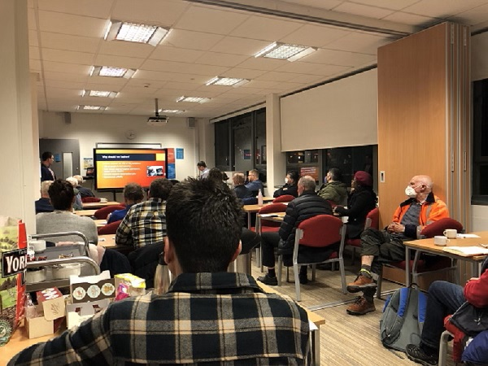
How?
National support & Funding: Externally funded through collaboration with others. There are no standardised qualifications that are government funded.
Training: Staff to be upskilled to deliver it - Expertise
Awareness

Slide 6
Future? Feedback is vital
We need feedback from employers in order to provide the curriculum the industry needs.
Harrogate College Employers Network
Next events in February Energy & Construction, Monday 14 February 2022, 9:30 – 11:30am

Slide 7
Any questions?

